Slide 1


Scalable, model-free online change point detection with NEWMA
N. Keriven¹, D. Garreau², I. Poli³
¹Ecole Normale Supérieure, Paris (CFM-ENS chair)
²Max Plank Institute, Tuebingen
³LightOn, Paris
Gipsa-Lab, Nov 2018

Slide 2
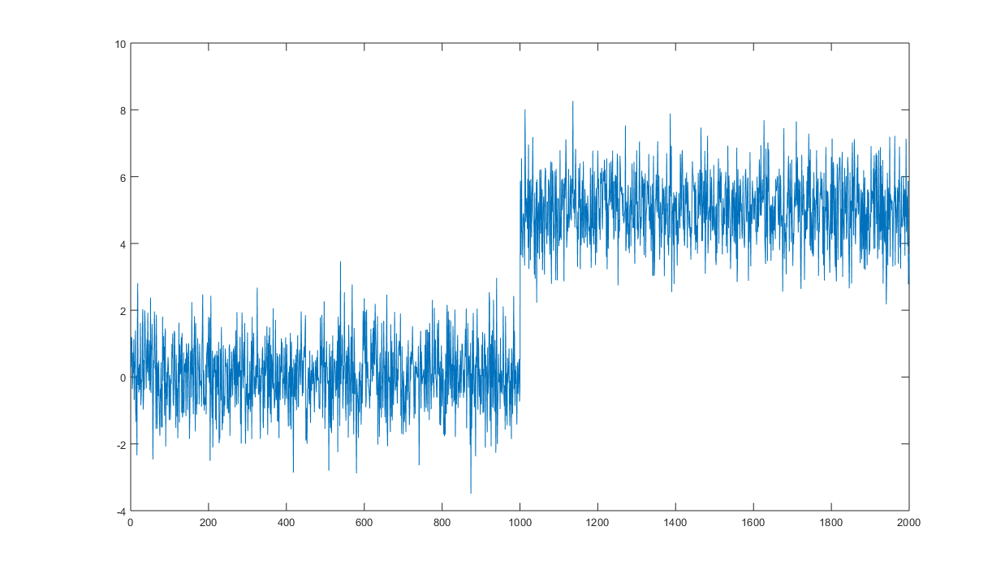

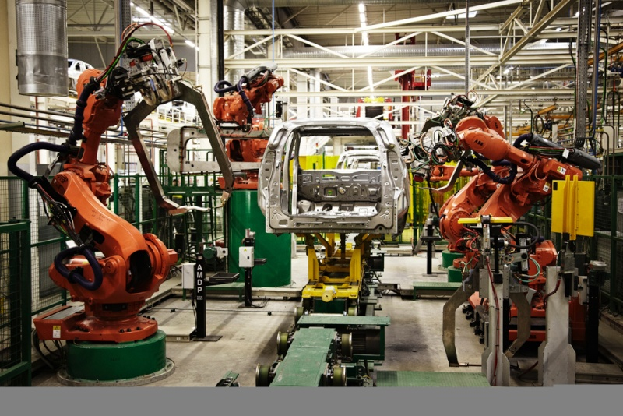
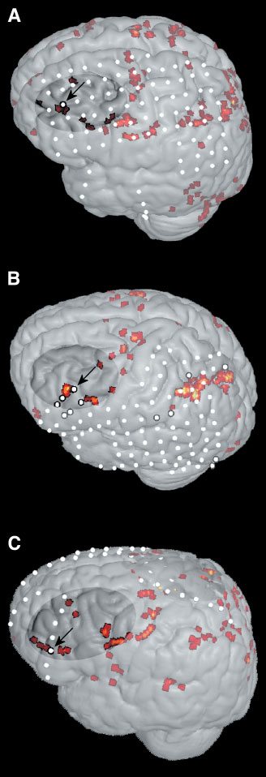
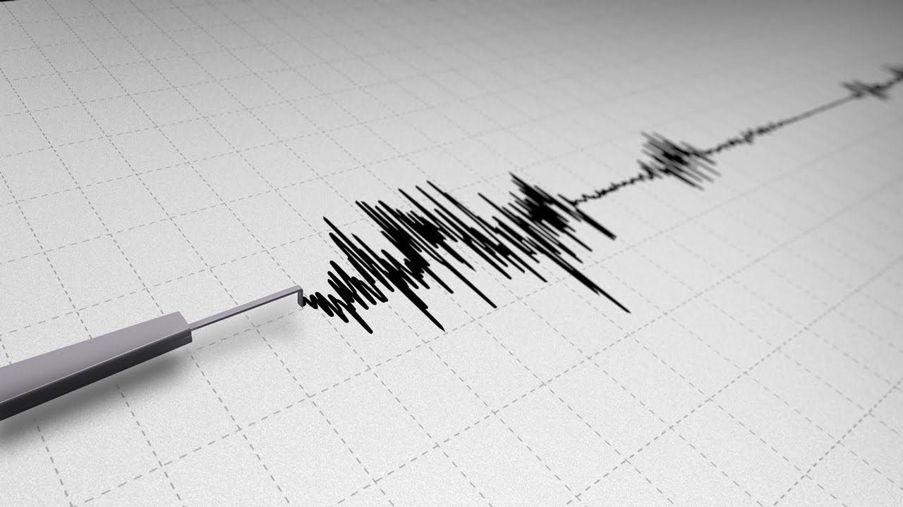
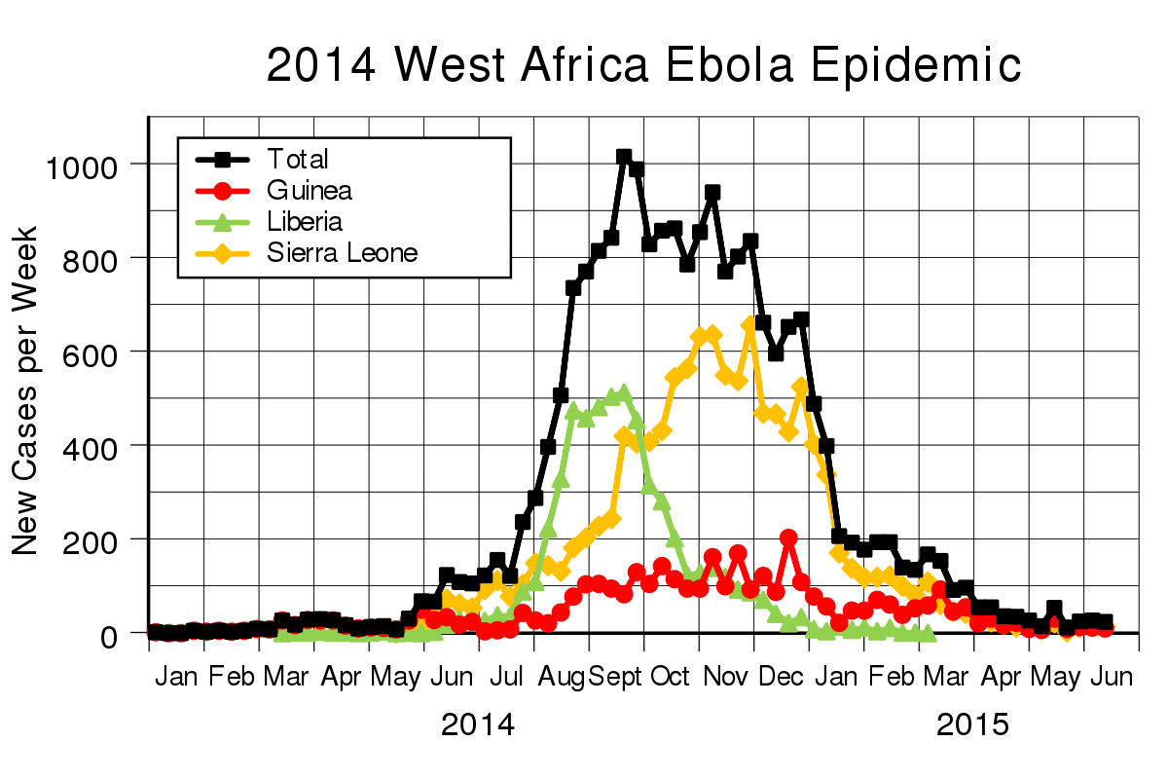
Change Point Detection
Goal:
Detect « changes » in a multivariate time series in an online fashion.
Long history of applications in:
Change point
Brain activity detection
Network intrusion
Fault detection in engineering systems
Seismic detection
Epidemic outbreaks…
Basseville, Nikiforov. Detection of abrupt changes. 1993

Slide 3

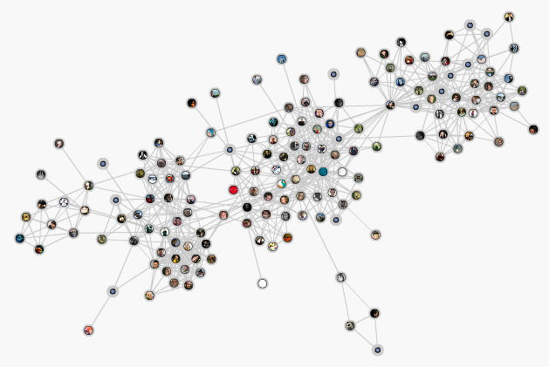

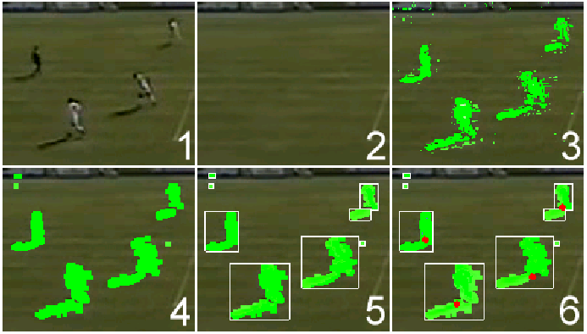
Modern challenge: scalability, sensitive data
Modern data ?
Heavy in memory
Sensitive, collected by personal devices
Need for methods that:
Are light and fast
Do not store raw data (« truly » online)
Can be performed on embedded devices with low power and memory
Real-time

Slide 4
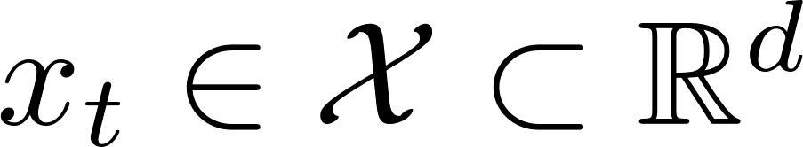
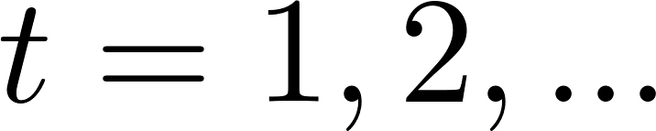
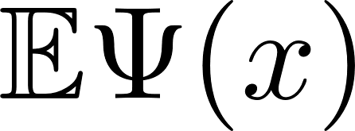
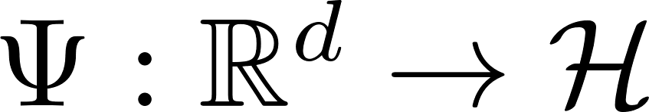
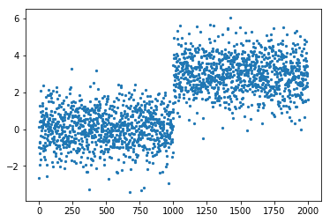
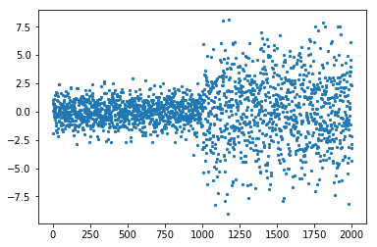
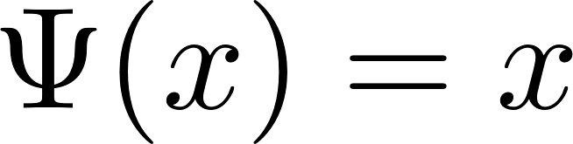
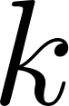
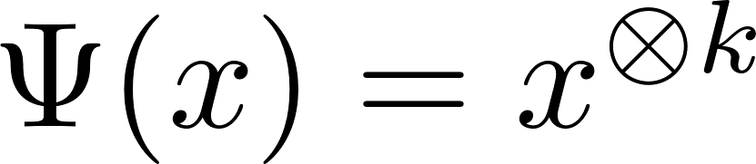
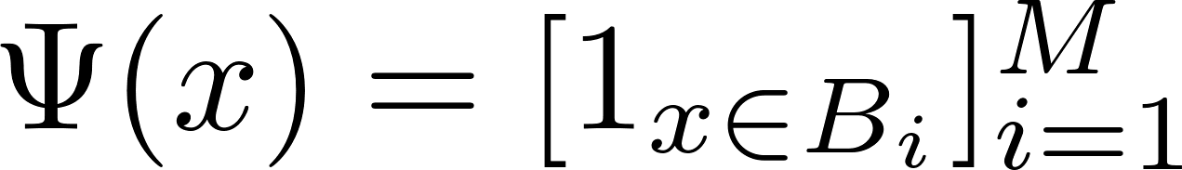
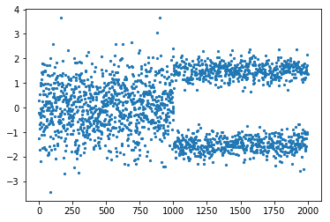
Framework
Time series
Algorithms designed to detect changes in some generalized moments
Examples:
Mean:
Moment of order :
Histogram:
Coming: random nonlinearities…
(user-chosen: a priori knowledge, « universal » ?)

Slide 5
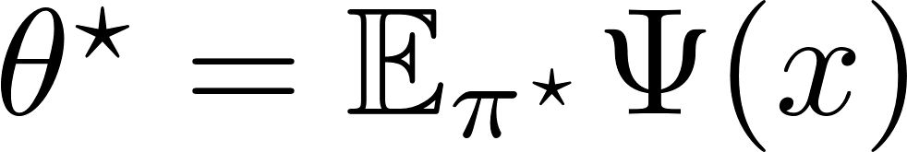
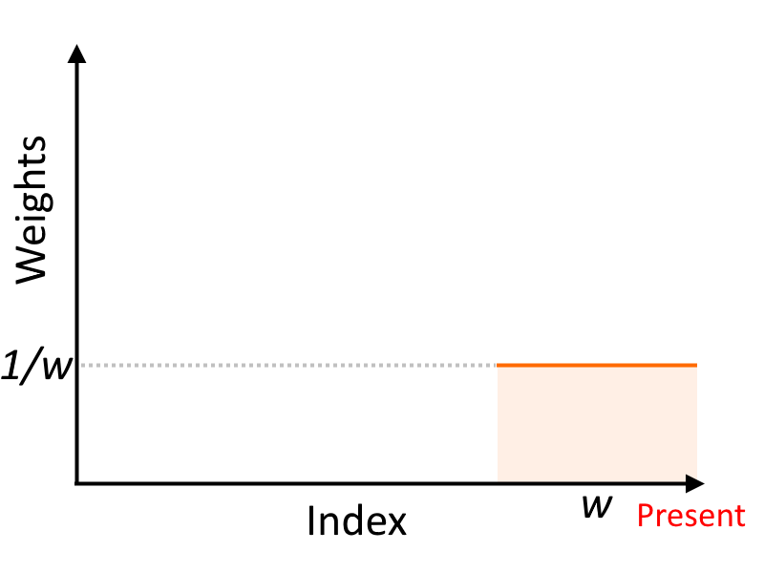
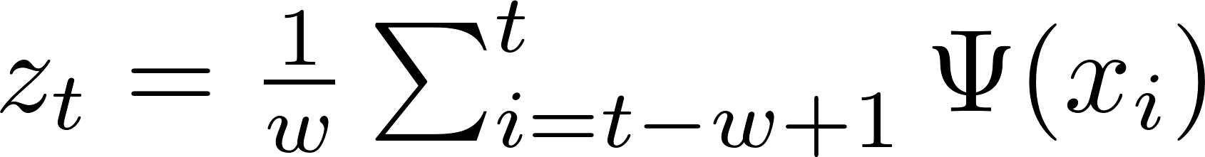
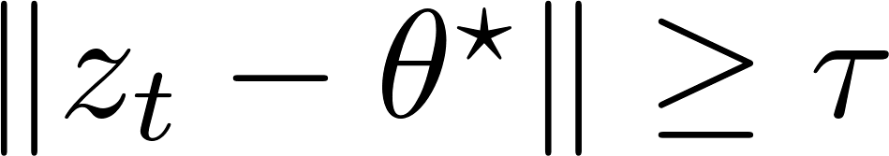
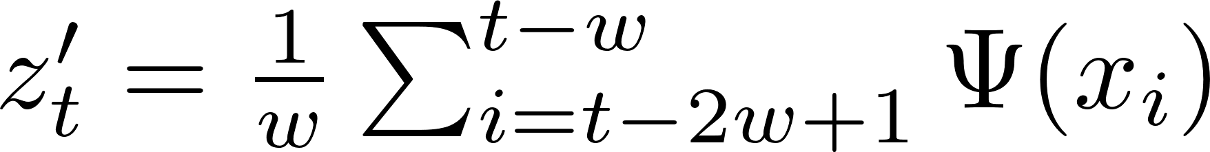

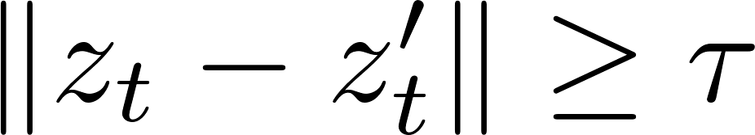
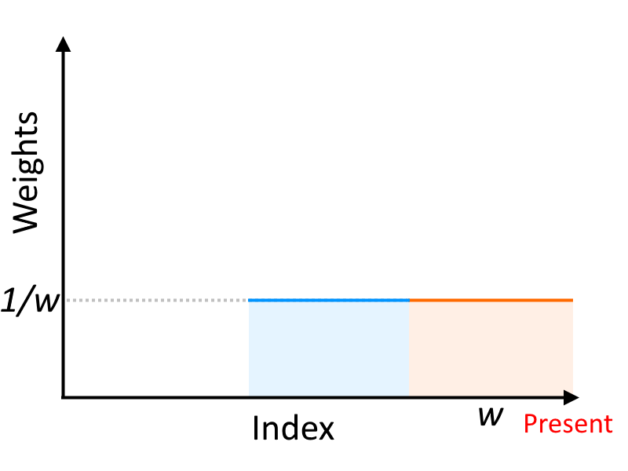
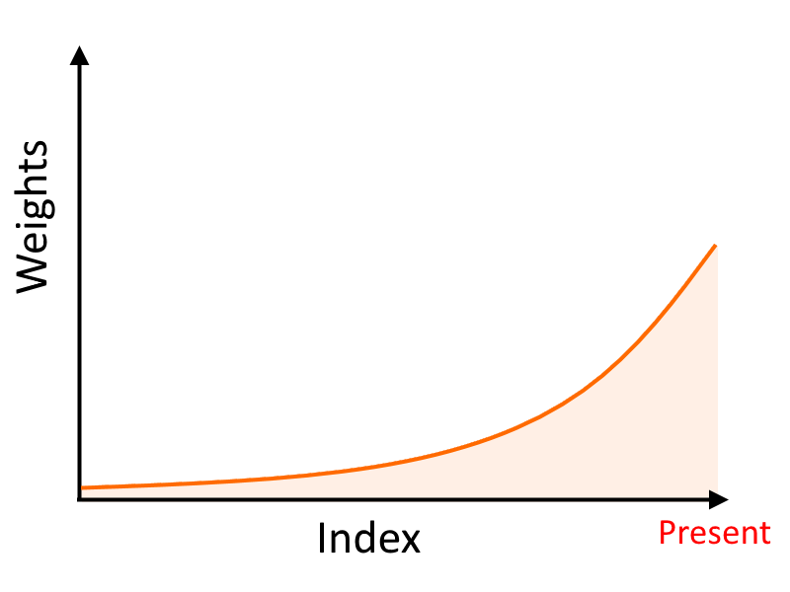

Context
Parametric: knowledge of « normal »
Non-parametric: « model-free »
Moving Average (MA)
(non-parametric) Moving average (MA)
Alarm
Alarm
Store raw data
Prior knowledge
Exponentially Weighted Moving Average (EWMA)
Alarm
Store raw data
No prior knowledge
Store only weighted average
Prior knowledge
Proposed: NEWMA

Slide 6


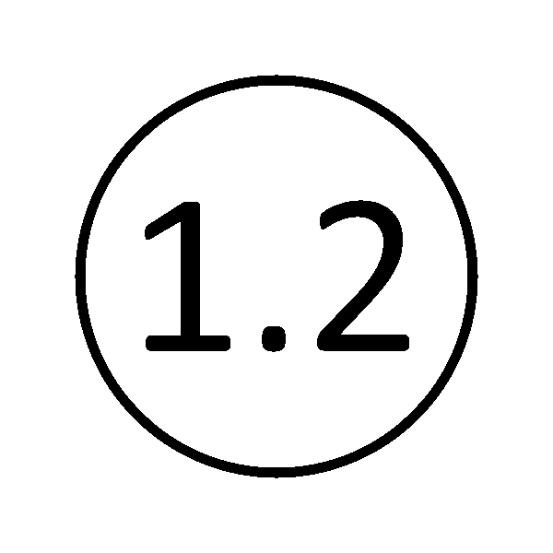

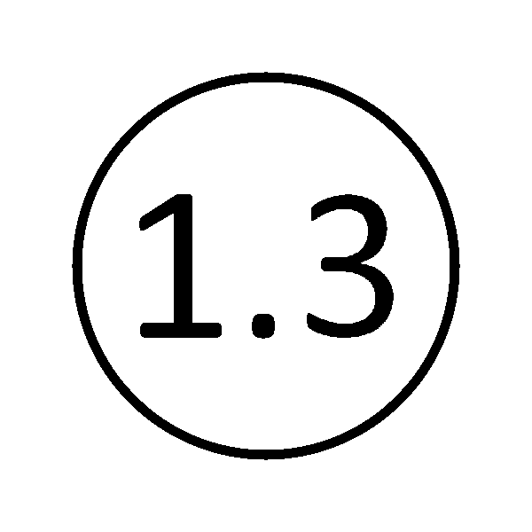
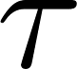


Outline
The NEWMA algorithm
Description
Choice of : random features
Setting the threshold
Experiments
Conclusion

Slide 7
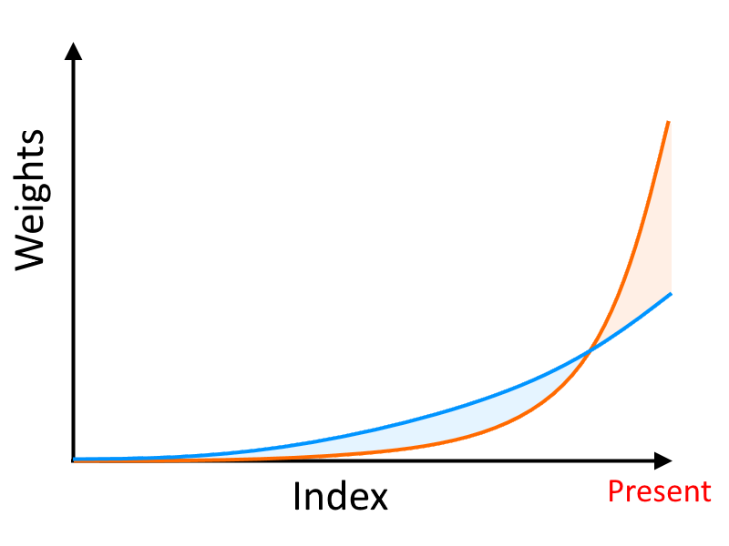
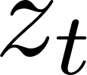
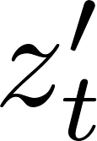

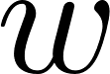
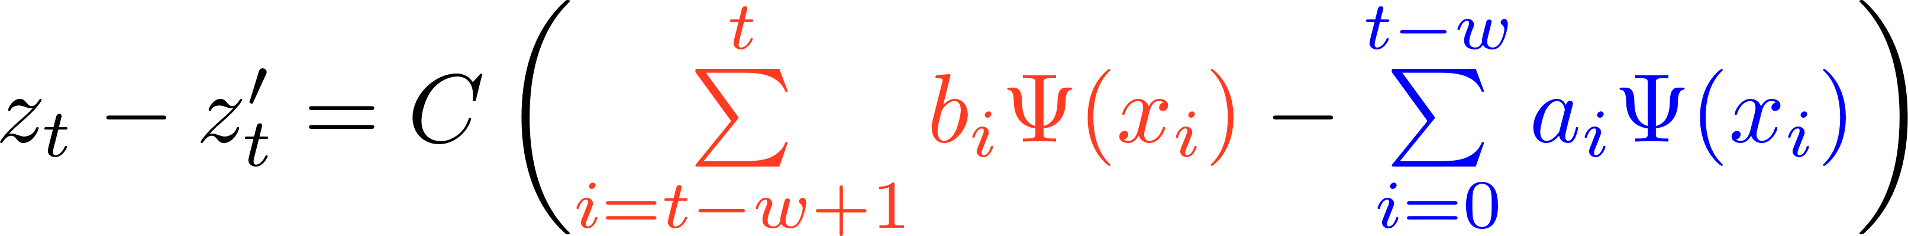
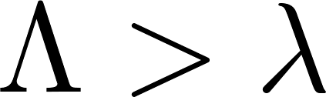
Proposed algorithm: NEWMA
EWMA
Scan
« No prior knowledge » EWMA: NEWMA
Idea:
compute two EWMAs with different forgetting factors
NEWMA compares implicitely old and new samples, without the need to explicitely store them
Prop.:
Alarm

Slide 8
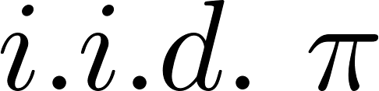
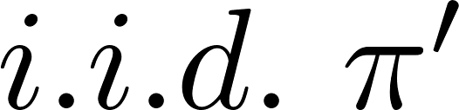
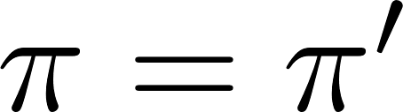
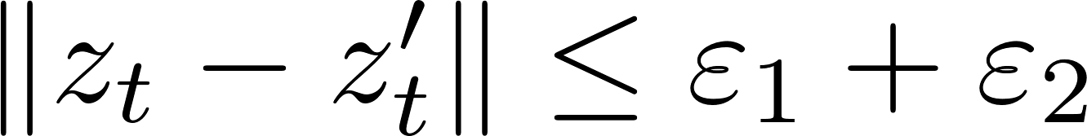
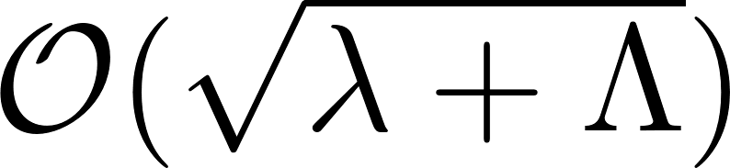
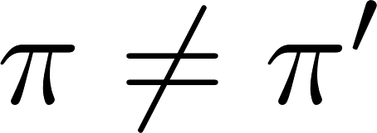
Pseudo-metric & pointwise concentration
Appropriate pseudo-metric:
Prop. : Assume bounded.
If , then whp
If , then whp
Initialization
Concentration ineq.

Slide 9


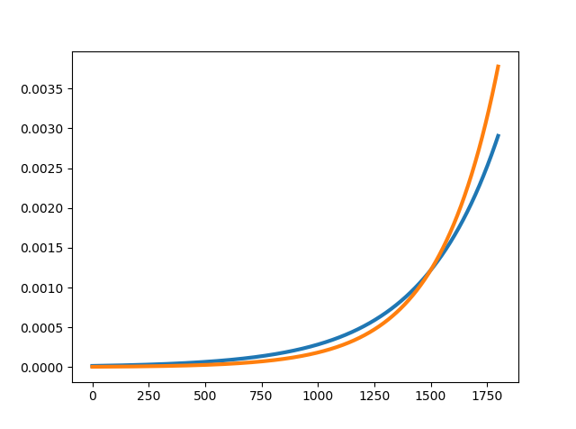
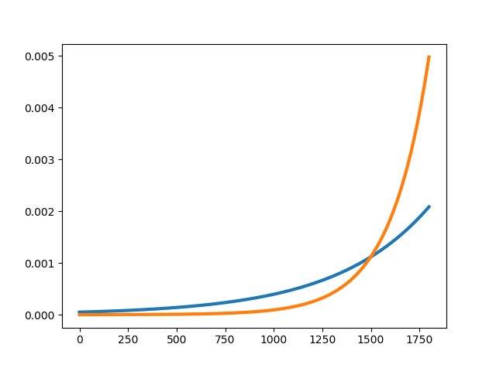
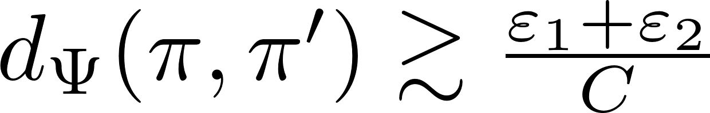
Choice of forgetting factors
Choice of parameters ?
Choosing and is not very intuitive…
Choosing the window size is much more convenient !
Given , which are the « best » and ?
We know that
Under the null:
Under a change:
Hence, detection « possible » if
Minimizing this detection threshold:
« Bad » choice
Using the heuristic

Slide 10


Outline
The NEWMA algorithm
Description
Choice of : random features
Setting the threshold
Experiments
Conclusion

Slide 11
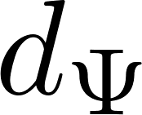
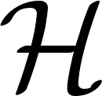
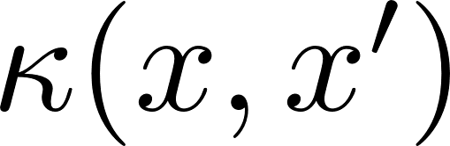
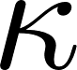
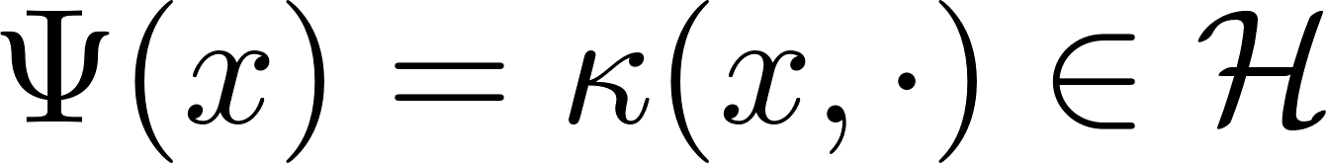
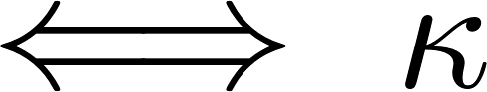
Good embedding ?
With no prior knowledge, which is « good » ?
Recall: pseudo-metric
and
Ideally, is a true metric:
Never true for finite-dimensional …
Def: MMD metric
Positive Definite kernel:
: Maximum Mean Discrepancy (MMD)
: RKHS associated to
[Gretton 2006, Borgwardt 2006]
Infinite-dimensional ! Not directly usable in practice…
Many usual kernels are characteristic:
Gaussian
Laplace
…
[Gretton 2006, Sriperumbudur 2010]:
true metric « characteristic »

Slide 12









MMD and random features
Usual estimation of the MMD: kernel trick
Infeasible for NEWMA:
no sample in memory = no kernel trick
Random features expansions of kernels [Rahimi 2007]
Hyp:
eg. any translation-invariant kernels:
w.h.p.:
Prop. : If
then, w.h.p. on and ,
If is « structured », can reduce further to the « intrinsic dimension » of …
[Keriven 2017, 2018]

Slide 13












Complexity
Algorithms:
Moving Average (MA)
Kernel Scan-B [Li 2015]
(MA with explicit MMD and several windows)
NEWMA
Random features:
Classical Random Fourier Features (RF)
« FastFood » Random Features [Le 2013] (FF)
LightOn’s Optical Random Features [Saade 2016] (OPU)
Time (1 iter.)
Memory
Time ( )
Memory ( )

Slide 14

Outline
The NEWMA algorithm
Description
Choice of : random features
Setting the threshold
Experiments
Conclusion

Slide 15














Classical strategy: under the null
Null hyp.: Assume all samples are drawn according to
Strategy 1: choose at a certain quantile of
Thm. : assume , take
Eigenvalues of some operator (from training data?)
Strategy 2: adjust desired Average Run Length
Thm: it is possible to adapt the Markov chain-based strategy of [Fu2002], initially for EWMA, to compute the theoretical ARL (no closed-form !)
Useful insight, but limited usability in practice… (beyond toy examples)
Q: In the case of multiple changes / no training data ?
Given training data, possible to simulate ARL

Slide 16





Online estimation of threshold
Proposed numerical heuristic: online estimation of the threshold
Any algorithm (MA, Scan-B, NEWMA…)
Futur work: theoretical analysis, principled choice of parameters…
Detection result on synthetic data
(varying threshold multiplier, lower left best):

Slide 17












Average Run Length
Null hyp.: Assume all samples are drawn according to
In expectation, how long before a false alarm?
Markov-chain based approach for (1d) EWMA [Fu 2002]:
Adaptation for NEWMA
Markov
Hyp.: finite-dim
Markov-chain
Discretize the domain with prec.
Compute (easy)
Show
Useful insight, but limited usability in practice… (beyond toy examples)
Discretize ( - coverings), and - bound the domain
Compute
Show

Slide 18


Outline
The NEWMA algorithm
Description
Choice of : random features
Setting the threshold
Experiments
Conclusion

Slide 19




Synthetic Data
Data: GMM with 10 components
Time of execution:
Detection result (varying threshold, lower left best):

Slide 20






Voice activity detection
+
Short Time Fourier Transform
Change point detection

Slide 21


Video monitoring
Apply NEWMA on each block of pixels:
Real-time, no GPU.
No need to record everything !

Slide 22

Outline
The NEWMA algorithm
Description
Choice of : random features
Setting the threshold
Experiments
Conclusion

Slide 23
Conclusion, outlooks
Introduced « No prior knowledge »-EWMA:
Simple but novel idea inspired by existing methods (EWMA and MA)
Compare old and recent samples without storing them in memory
Faster than existing non-parametric methods
Addition of Random Features to use the MMD between distributions
Use of OPU for constant-time Random Feature
Outlooks:
Application to dynamic graph
Non-iid…
What is a good ? What is the corresponding ?
Learn the to be sensitive to only selected changes ?
For structured (sparse) data, limit the number of features
Application in stochastic quasi-Newton optimization…

Slide 24

Thank you !
Keriven, Garreau, Poli. NEWMA: a new method for scalable model-free online change-point detection. Submitted. arXiv:1805.08061
Code: github.com/lightonai/newma
data-ens.github.io
Enter the data challenges!
Come to the colloquium!
Come to the Laplace seminars!
« Laplace » post-doc:
data-ens.github.io/jobs/
Deadline Dec. 31st 2018

